Slide 1

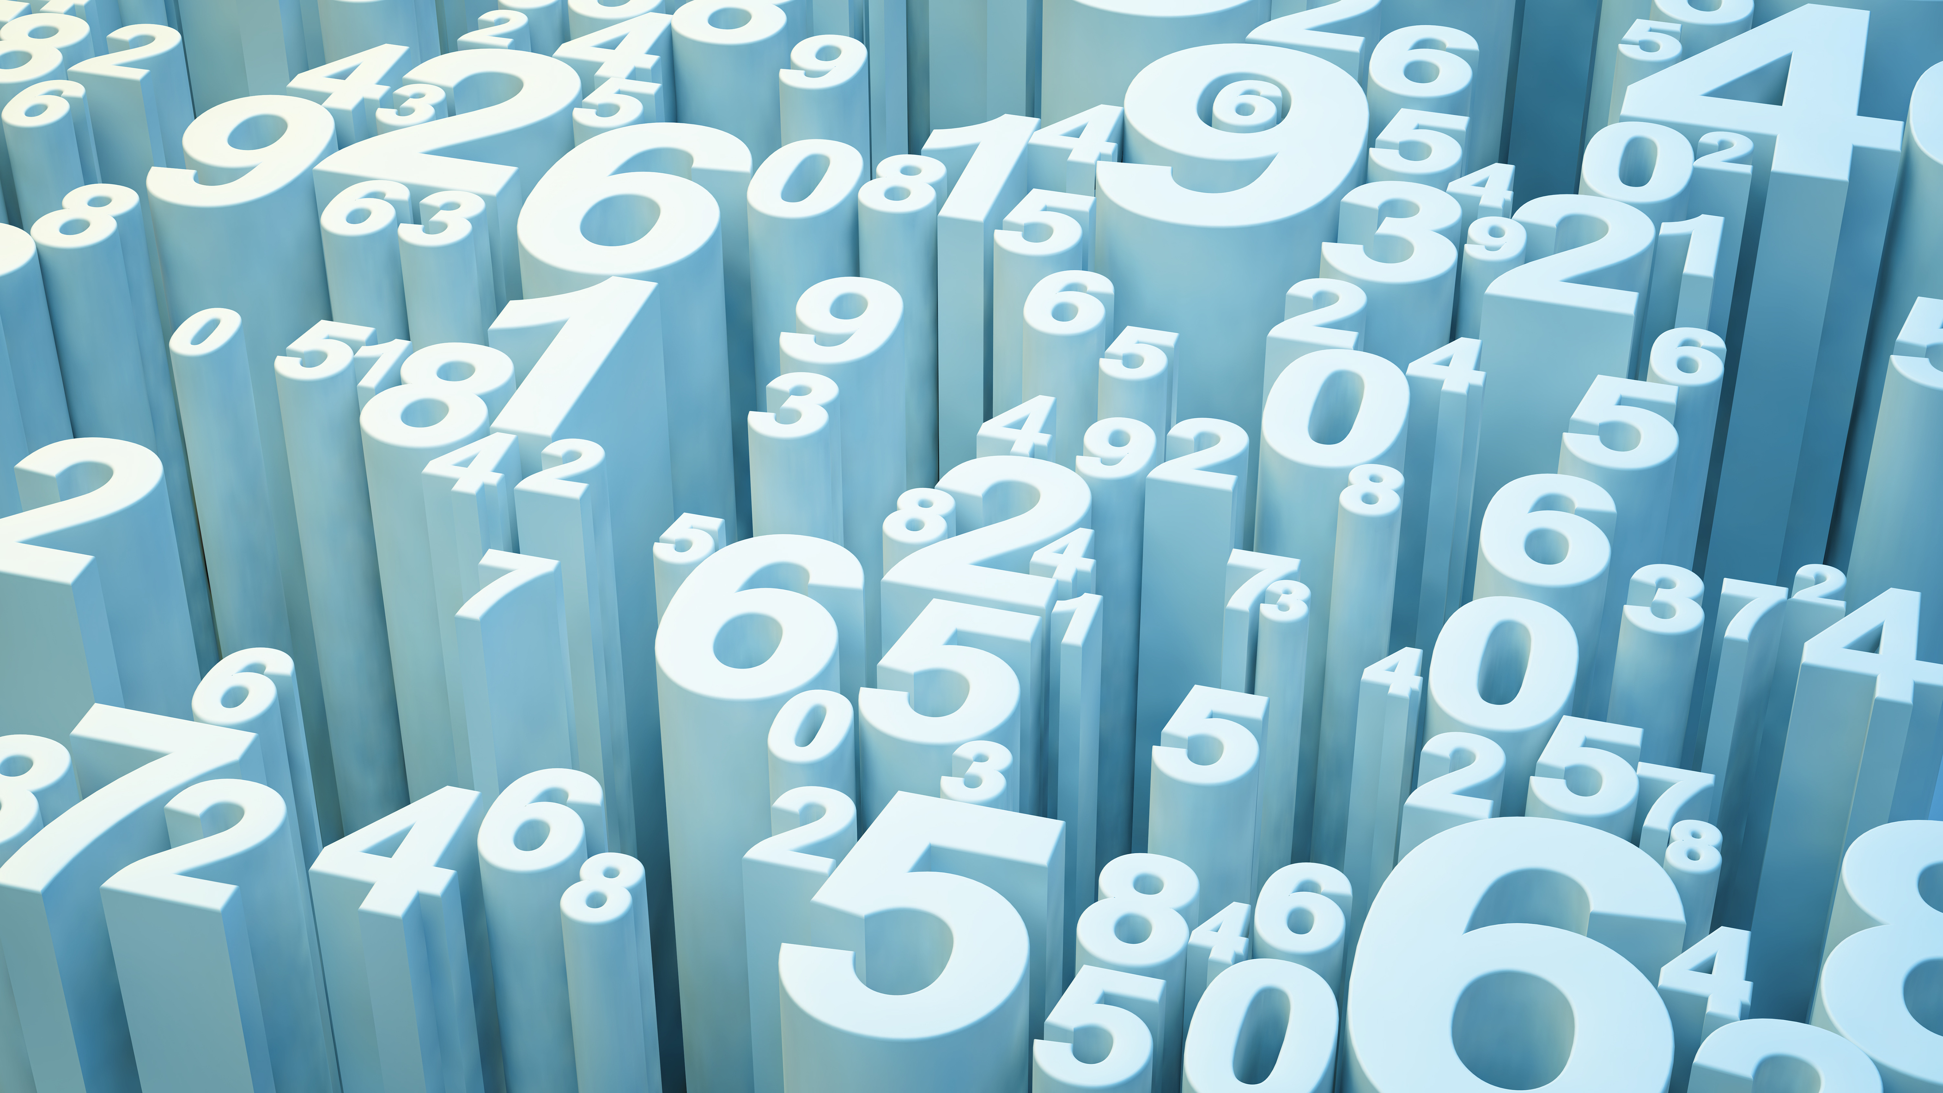
Computer Hardware
By
Muppidi Ajay Kumar

Slide 2
Computer Hardware
It is Physical parts of computer which we can see, Touch and feel and can’t be changed continuously according to our preference is known as Computer Hardware

Slide 3
What are the main components of computer hardware consisting of:-
Input Devices:
Keyboard
Mouse
Joystick,…
Output Devices:
Monitor
Printers
Speakers,…
CPU/ALU:
Processor
Motherboard,…

Slide 4
Flowchart and Pseudocode

Slide 5
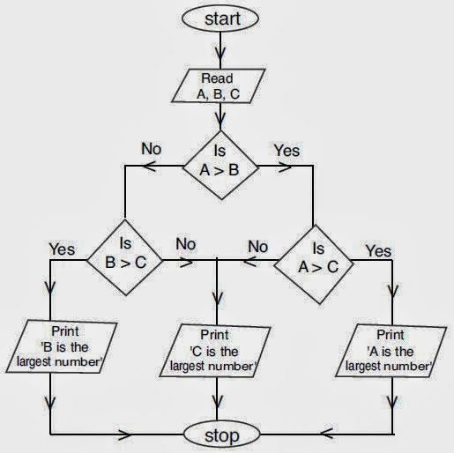
Flowchart

Slide 6
Pseudocode
Python Code:
a = float(input("Enter first number: "))
b = float(input("Enter second number: "))
c = float(input("Enter third number: "))
if (a >= b) and (a >= c):
largest = a
elif (b >= a) and (b >= c):
largest = b
else:
largest = c
print("The largest number is", largest)

